Slide 1
PPS MINIPROJECT

Slide 2
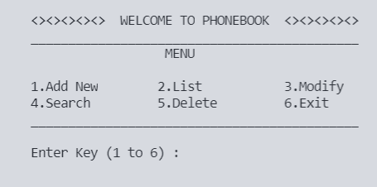
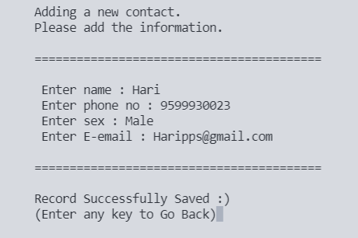
PHONEBOOK MANAGEMENT SYSTEM:
This project focuses on adding, editing, deleting and searching contacts. It is a simple C project using file handling, storing data in array, etc.
This project is done by
Harinarayanan.R RA2111026010424
Derill Sebiraj RA2111026010401
Indrajeet Sarkar RA2111026010432

Slide 3
FLOW-CHART

Slide 4
Flow-Chart
Skeletal structure of the Phonebook program.
Importing the necessary libraries.
Defining the main function.
Starting of the program
Declaring the function prototype.

Slide 5
Defining the functions that are declared.
Printing the necessary the values as required by user
End of the Program
Storing the necessary value in file.

Slide 6
FUNCTION EXPLANTION

Slide 7
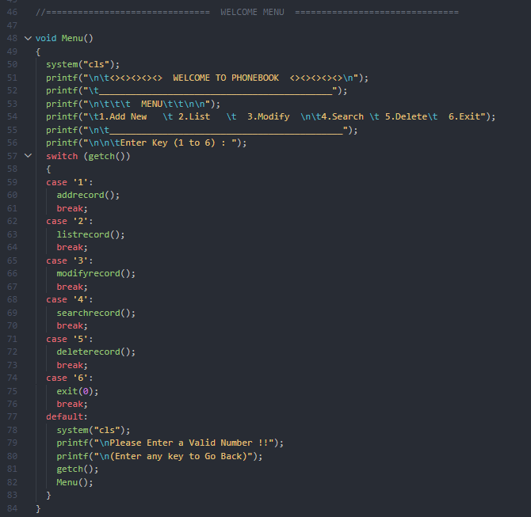
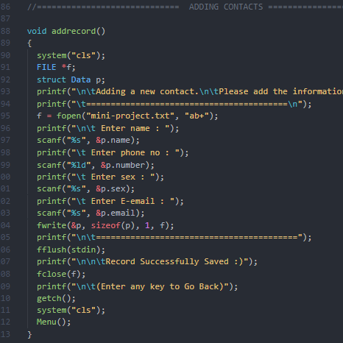
Menu function
This is a recursive function used to display menu. This functions calls other function for various processes. Switch statement is used to change between various functions . Once the specific function is run, it calls menu function (recursive).
Function Explanation
Add-record function
This function gets the contact details from user (scanf). It opens a file (fopen) and stores all the input given by the user using fwrite. Once the data is saved, the file is closed, and it calls back menu function.

Slide 8
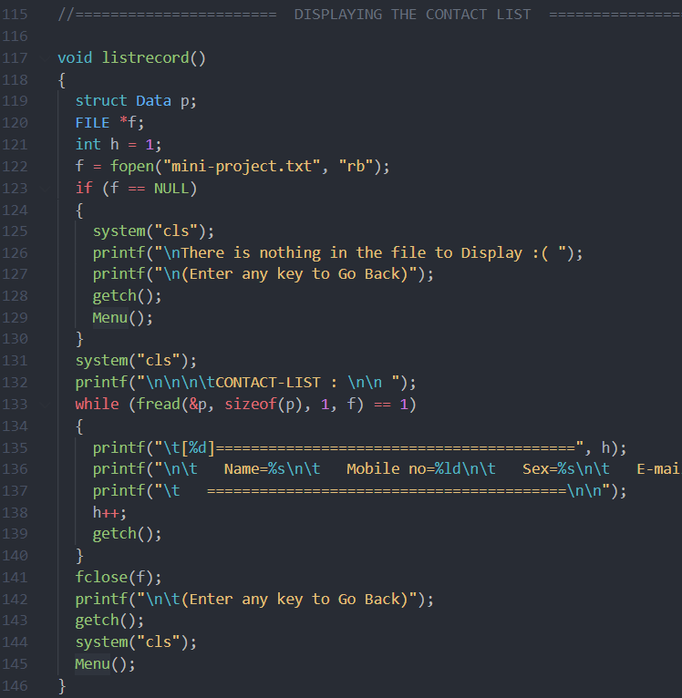
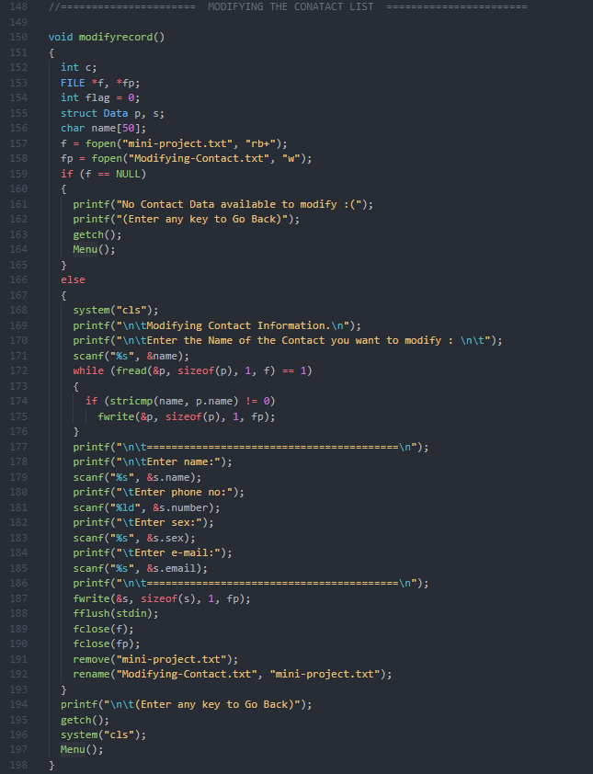
List-record Function
This function displays the various records entered by the user (stored in the file) through add-record function. It opens the file in which the data is previously stored. Once it is complete, it calls back the menu function.
Function Explanation
Modify-record Function
This functions is used to edit the previously added data. A temporary file is created in which all the data is saved and then renamed same as the original file. The original file is deleted before renaming the temporary one.

Slide 9
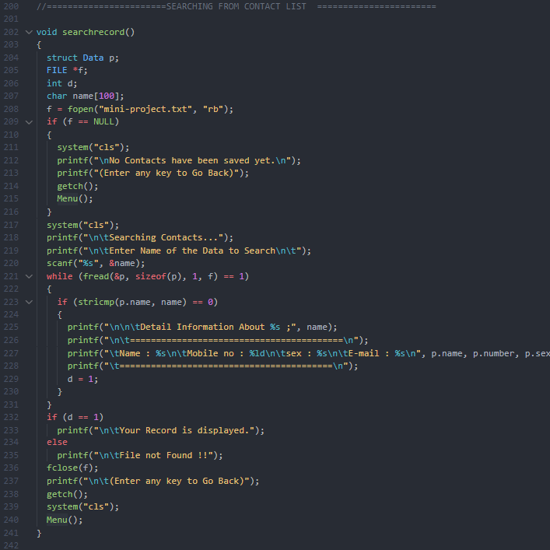
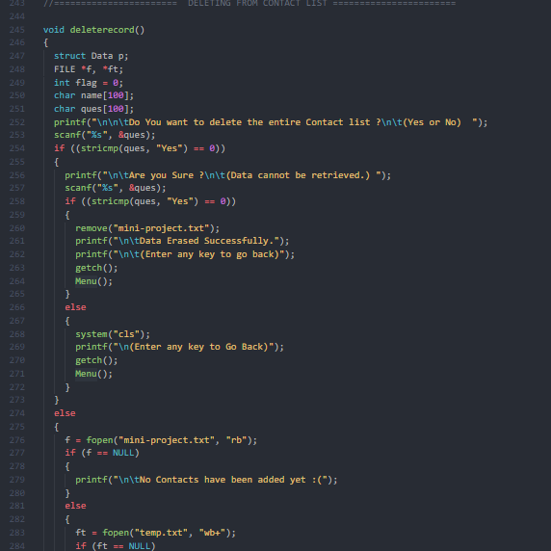
Search-record Function
This function displays the details of a specific contact by using name as a search keyword.
It compares the name entered by the user in the file and Displays the info of the user who has the same name. If No name matches it displays an error.
Function Explanation
Delete-record Function
This function delete’s either the entire file or just some contacts. User enter the name of the contact to be deleted. All data is stored in a temporary file expect the contact to be deleted. The original file is deleted and the temporary file is rename as the original one.

Slide 10
OUTPUT

Slide 11
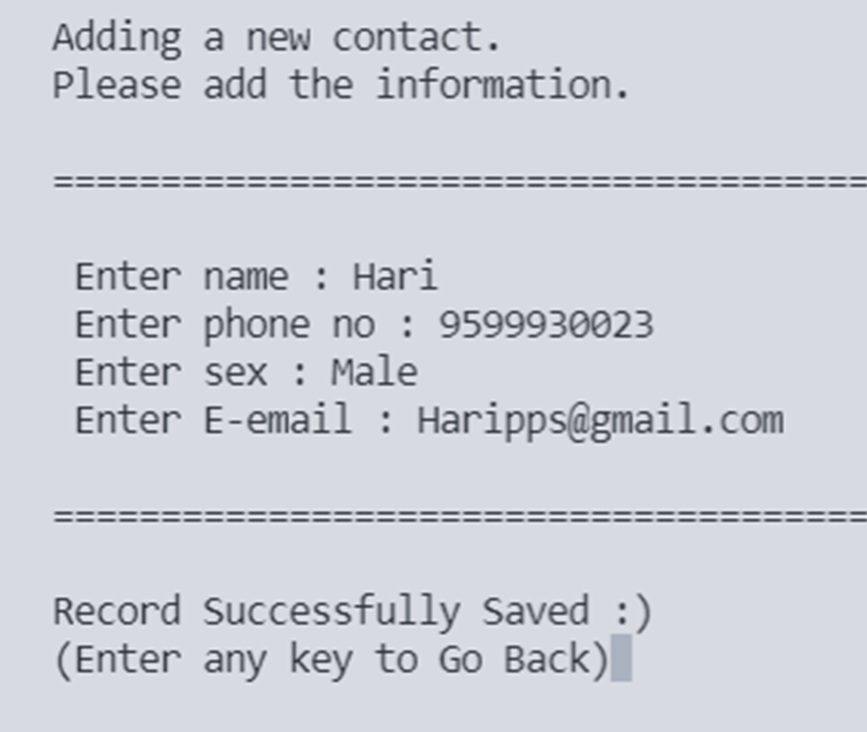
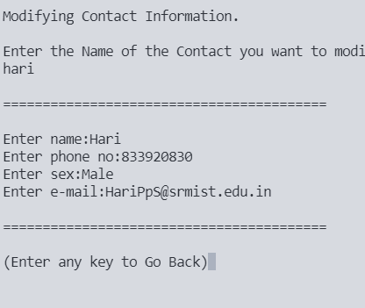
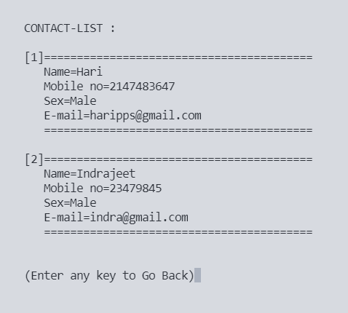
List-record Output
This function displays all the contacts which have been added.
Add-record Output
Modify-record Output
Once the Data is inputted by the user, This is the output that is displayed.
This enables the user to edit a contact, and this is the output once the data is entered.

Slide 12
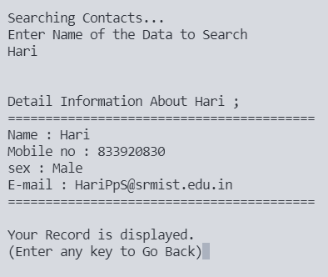
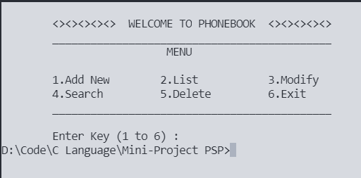
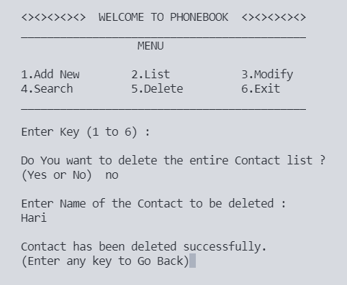
Delete-record Output
This functions enable to delete a specific contact or the entire file.
Search-record Output
Exit-Function Output
This enables the user to look for a specific contact based on the name entered by the user.
This is used to come out of the program.

Slide 13
THANK YOU

